Slide 1
Airflow Introduction
Xiaolong LI
June 2017

Slide 2
Introduction
Airflow is a platform to programmatically author, schedule and monitor workflows.
Apache Airflow is an effort undergoing incubation at The Apache Software Foundation (ASF), sponsored by the Apache Incubator.

Slide 3
Features
Dynamic: Airflow pipelines are configuration as code (Python).
Extensible: Easily define your own operators, executors and extend the library so that it fits the level of abstraction that suits your environment.
Rich user interface: makes it easy to visualize pipelines running in production, monitor progress, and troubleshoot issues when needed.
Airflow UI: make it easy to monitor and troubleshoot your data pipelines.

Slide 4
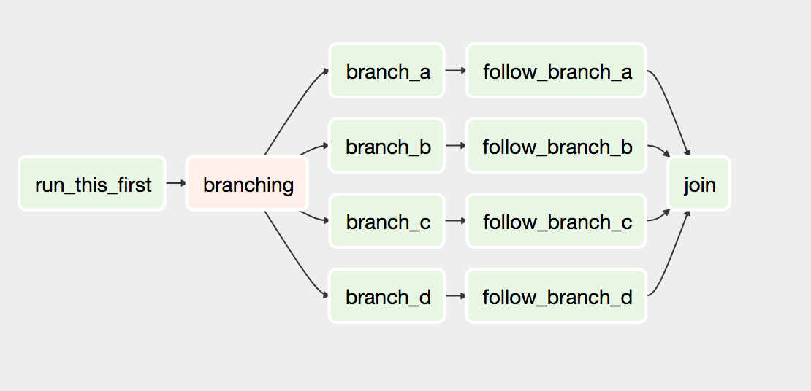
Concepts
DAGs: In Airflow, a DAG – or a Directed Acyclic Graph – is a collection of all the tasks you want to run, organized in a way that reflects their relationships and dependencies.

Slide 5
Concepts
Operator: a class that .acts as a template for carrying out some work
Task: a parameterized instance of an operator
Task Instance: a task that 1) has been assigned to a DAG and 2) has a state associated with a specific run of the DAG
Hooks: interfaces to external platforms and databases like Hive, S3, MySQL, Postgres, HDFS, and Pig.
Xcoms: let tasks exchange messages, allowing more nuanced forms of control and shared state.
Connections: The connection information to external systems is stored in the Airflow metadata database

Slide 6
Example
pip install airflow
pip install airflow[mysql]
pip install airflow[celery]
export AIRFLOW_HOME=~/airflow
airflow initdb
airflow worker
airflow scheduler
airflow webserver
Tutorial

Slide 7
End
参考
https://airflow.incubator.apache.org/index.html

